Slide 1
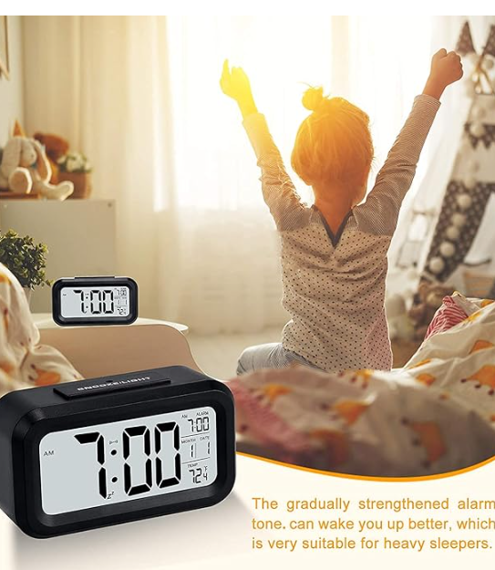
Understanding Digital Clock through Reverse Engineering
Mayank Yadav (B22221) Medaboina Preetham (B22222)

Slide 2
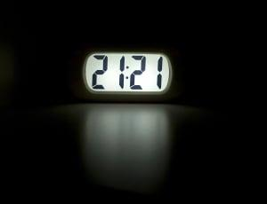
Introduction
Basic Background:
A digital clock is an electrical device displaying time in numerical digits on an LCD.
Initially used for scientific and industrial applications, digital clocks gained popularity in homes and businesses.
Importance:
Ensures precision in timekeeping, enhancing efficiency in daily activities.
Integral to smart home ecosystems and modern time management.
Need for Reverse Engineering:
Essential for understanding competitors' technology and uncovering areas for innovation.
Improves manufacturing processes, product performance, and market competitiveness.

Slide 3
Product Design Specifications
Specification | Description
Function | To show Time and Alarm (also Temperature in some models)
Power Source | Operates on DC Supply
Voltage | 4.5V (3*AAA type batteries)
Color | Solid Black
Material | Plastic (Acrylonitrile Butadiene Styrene)
Height | 7.6 cm / 2.92 in
Width | 4.5 cm
Breadth | 13.6 cm / 5.34 in
Weight | 153 gm
Display Type | Digital LCD display Multisegment
Backlight | Automatic environment detection and response
Performance and UI | Responds quickly to input commands with a user-friendly interface

Slide 4
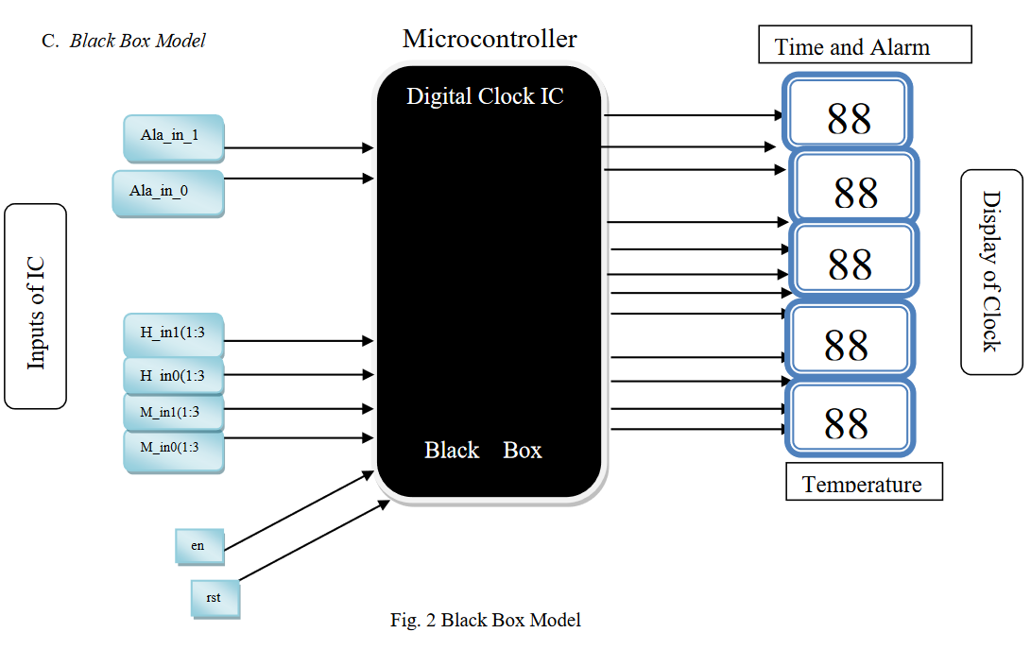
Black Box Model

Slide 5
Manufacturing Process of Different Parts with Justification
Circuit Board (PCB)
Manufacturing Process: Designing, Etching, Lamination, Drilling, Plating, etc.
Justification: Cost-effective in bulk manufacturing, reliable electrical connections, compact, customizable.
Microcontroller Unit (MCU)
Manufacturing Process: Semiconductor device fabrication, using VLSI techniques.
Justification: Enables miniaturization and density for powerful and efficient MCU.
3. LED (Backlight)
Manufacturing Process: Phosphor deposition and photolithography.
Justification: Precision, controllable light spectrum, efficiency, and durability.
4. LCD Display
Manufacturing Process: TFT fabrication and liquid crystal injection.
Justification: Energy-efficient design, clear displays, minimal power consumption.

Slide 6



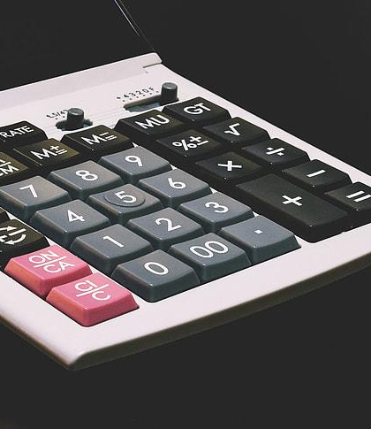


Some Specific Terms Which are Important To Discuss
Function
Material
Time, date, and temperature measurement with automatic night light sensor.
Durable plastic, lightweight, suitable for various environments.
Performance
Dimensions
Accurate timekeeping with less than 0.5% error, reliable temperature measurement, high-performance quartz for stable frequencies.
Compact and space-efficient design (14W x 8H cm).
Safety
Energy Saving
Eco-friendly materials adhering to global sustainable standards.
Low power consumption, battery-powered.

Slide 7
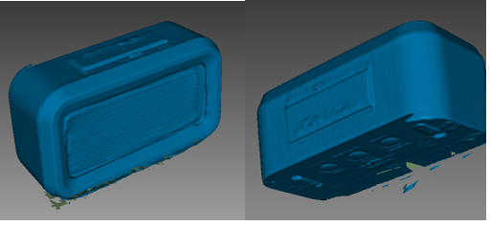
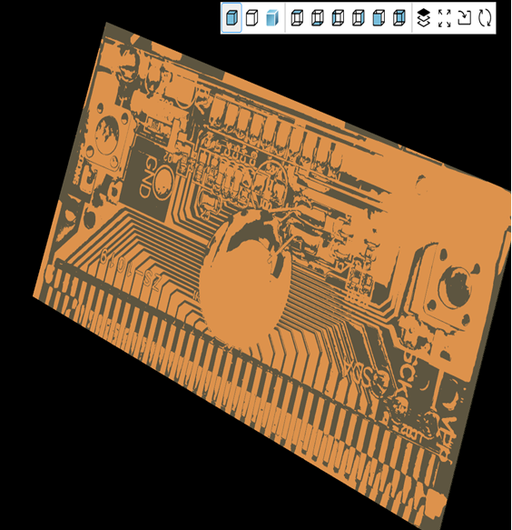
3D Scanned Model of the Product
PCB and Internal Working
A digital alarm clock uses a quartz crystal oscillator to generate a precise timekeeping signal, which is counted by a microcontroller to keep track of time. The microcontroller compares this count to the user-set alarm time, and upon a match, activates a sound circuit via an electronic switch or transistor. The time is displayed using a seven-segment LED or LCD driven by the microcontroller.

Slide 8
Standards Associated with Different Parts
Standard Aspect | Standard Name | Standard Number | Description
Safety | International Electrotechnical Commission | IEC 60950-1 | Ensures electrical safety standards for IT equipment like digital alarm clocks, including rigorous testing.
Environment | International Organization for Standardization | ISO 14062 | Specifies how to include environmental considerations into product design to reduce environmental impact.
Performance Testing | International Electrotechnical Commission | IEC 60051-1 | Defines criteria for analog electrical measuring instruments, ensuring accurate and consistent measurement.
Energy Saving | ENERGY STAR | --------------- | Assures products meet energy efficiency standards, reducing environmental impact and saving energy.
Commercialization | International Organization for Standardization | ISO 9001 | Provides standards for quality management systems, ensuring product quality and customer satisfaction.

Slide 9
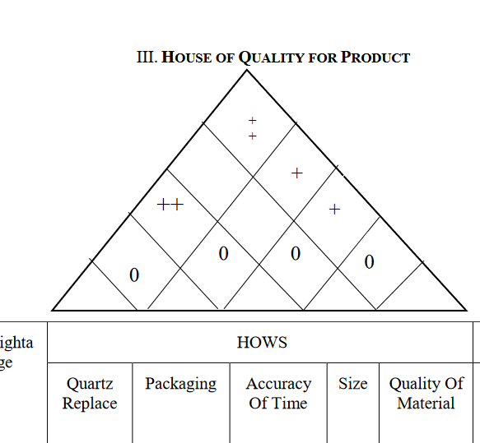
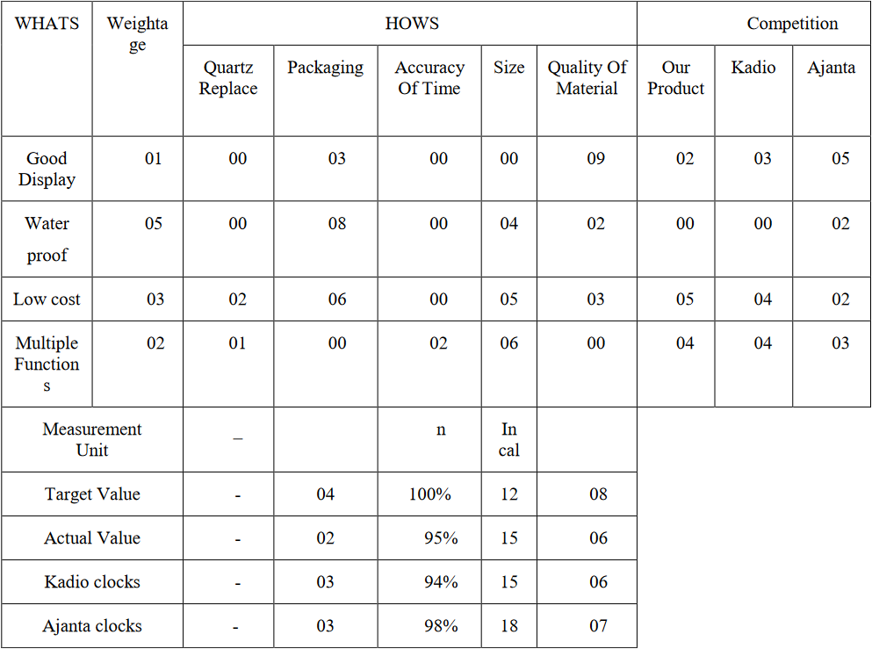
House of Quality

Slide 10
House of Quality for Product
The House of Quality (HOQ) provides a framework to analyze product features and compare them to competitors' offerings, focusing on customer preferences and strategic areas for improvement.
A. Weightage Assignment
The first stage in our study is to give weight to the various features based on their relative value to potential customers, directing attention towards factors that significantly influence purchase decisions.
B. How’s Analysis
The "How's" section provides a comparative assessment of each attribute for "Our Product" and competitors like Kadio and Ajanta clocks, identifying strengths and areas needing improvement.
C. Competition Comparison
This section directly compares "Our Product" against Kadio and Ajanta across various metrics, identifying areas where our product excels and opportunities for improvement.

Slide 11
Challenges in Existing Design
Display Visibility
Complex UI
Single Alarm Sound
Multiple PCB Boards
Not Water Resistant
Not Rechargeable Batteries
Use high-contrast screens with adjustable brightness settings to enhance visibility in various lighting conditions, including auto-dimming based on ambient light levels.
Simplify the user interface by incorporating touch panels or single set buttons for easier time and function settings.
Enable multiple alarm sounds and customizable tunes, including an intensifying sound feature for alarms not turned off promptly.
Consolidate to a single PCB board to reduce cost, manufacturing, and assembly time, minimizing wire use and enhancing efficiency.
Make the clock water-resistant by adding rubber seals or using TPE plastic, allowing outdoor use and increasing market differentiation.
Replace disposable batteries with built-in rechargeable batteries to promote environmental sustainability and consumer convenience.

Slide 12
Summary
From This we can infer that how a digital clock is made and about its internal working. This opens up a great possibility of the further development of the Product according to the Needs of the Customers and This opens up new new possibilities and establishes standards for the creation of new products in the digital timekeeping sector. This study demonstrates the possibility for ongoing consumer electronics innovation in addition to highlighting the importance of reverse engineering.

Slide 13
Thank you
- Mayank Yadav
Medaboina Preetham

